Slide 1






NASA Vision 2030 CFD Code
Final Technical Review
Contract # NNL08AA16B (Order # NNL12AD05T)
Deliverable # 6
November 14, 2013
NASA Langley Research Center
Jeffrey Slotnick Principal Investigator Boeing Research & Technology jeffrey.p.slotnick@boeing.com | Abdi Khodadoust Project Manager Boeing Research & Technology abdollah.khodadoust@boeing.com
Juan Alonso Stanford University | David Darmofal Massachusetts Inst. Of Technology | William Gropp National Center for Supercomputing Applications | Elizabeth Lurie Pratt & Whitney – United Technologies | Dimitri Mavriplis University of Wyoming

Slide 2
Outline
Acknowledgments
Introductions
Overview of Study
Findings
Vision
Technology Development Plan
Recommendations
Answers to Key NASA questions

Slide 3
Acknowledgments
Extended Vision 2030 Team:
  Joerg Gablonsky, Mori Mani, Robert Narducci, Philippe Spalart, and Venkat Venkatakrishnan – The Boeing Company
  Robert Bush – Pratt & Whitney
NASA Technical Monitor – Mujeeb Malik
NASA Contracting Officer Representative – Bil Kleb
All attendees at the Vision 2030 CFD Workshop (May 2013), especially our invited speakers:
  Paul Durbin – Iowa State University
  Sharath Girimaji – Texas A&M University
  Brian Smith – Lockheed Martin Corporation
All who participated in the Vision 2030 CFD Survey
3
Notes:
3

Slide 4
Introductions
4
Notes:
4

Slide 5
Overview of Study
“...Address(es) the long range planning required by NASA’s Revolutionary Computational Aerosciences (RCA) sub-project, (which is managed under the Aeronautical Sciences Project) of the Fundamental Aeronautics Program (FAP)”
  “…provide a knowledge-based forecast of the future computational capabilities required for turbulent, transitional, and reacting flow simulations…”
  “…and to lay the foundation for the development of a future framework/environment where physics-based, accurate predictions of complex turbulent flows, including flow separation, can be accomplished routinely and efficiently in cooperation with other physics-based simulations to enable multi-physics analysis and design.”
5
Notes:
5

Slide 6
Overview of Study CONTINUED
Create a comprehensive and enduring vision of CFD technology and capabilities:
  Define/develop CFD requirements
  Identify shortcomings and impediments
  Develop a long-term, actionable research plan
  Develop a detailed technology development roadmap to
    capture anticipated technology trends and future technological challenges,
    guide investments for long-term research activities,
    and provide focus to the broader CFD community for future research activities
“… the roadmap will aid and support NASA’s long-range research planning of FAP program elements and exploit developments in physical modeling, numerical methods, software, and computer hardware to develop a system-level view of the technology required for a 2030 CFD code”
Notes:
6

Slide 7
Overview of Study CONTINUED
Develop and execute a comprehensive CFD community survey to refine the technical requirements, gaps, and impediments
Based on the refined vision, hold a CFD workshop among subject matter experts within industry, government, and academia to:
  Get a definitive view on the relative priorities and importance of the impediments that need to be overcome
  Develop realistic options for technical approaches and ideas for improving the CFD capability
  Assemble suggested plans for maturing CFD technologies through the Technology Readiness Level (TRL) scale, including requirements for validation and computational resources
  Develop a preliminary timeline for research
Develop and deliver a final report summarizing findings and recommendations
7
Notes:
7

Slide 8
Overview of Study CONTINUED
Key NASA Questions:
  What hardware requirements and software attributes will characterize an advanced “Vision 2030” CFD code that is used to routinely compute complex turbulent flows, involving flow separation, at subsonic, supersonic, and hypersonic speeds, and exhibits greater robustness than current technology?
  How many orders of magnitude faster (time-to-solution), as compared with current capabilities, will 2030 CFD technology be?
  What will be the fundamental elements of 2030 turbulence models, and for what classes of problems will they be reliable?
  What are the principal impediments, both modeling and algorithmic, that must be overcome to achieve the 2030 CFD vision?
  What high-risk/high-yield obstacles remain as enduring and daunting challenges that should be the focus of long-range efforts by NASA?
Notes:
8

Slide 9
Findings
NASA investment in basic research and technology development for simulation-based analysis and design has declined significantly in the last decade and must be reinvigorated if substantial advances in simulation capability are to be achieved.
  Physics-based simulation is a cross-cutting technology that impacts all of NASA aeronautics missions and vehicle classes – NAE Decadal Survey
  Advances in simulation capabilities are often driven by the requirement of short-term impact, or in response to simulation failure on a program → results in incremental improvements to CFD software
  International government agencies (e.g., DLR, ONERA) routinely have base research and technology (R/T) elements as part of their long-term technology strategies
  NASA’s Revolutionary Computational Aerosciences (RCA) project is a step in the right direction and should be maintained and expanded
Notes:
9

Slide 10
Findings CONTINUED
HPC hardware is progressing rapidly and technologies that will prevail are difficult to predict.
  Current advances in exascale hardware architecture involve scalar processors with 1000s of “streaming” processor cores, highly parallel memory interfaces, and advanced interconnects → focus is on power consumption and failure recovery
  Advanced software programming environments with higher levels of software abstraction will be required
  Current CFD tools and processes do not scale well on these systems → improved software development, implementation, and testing is needed
  Alternative computing architectures are under development:
    Quantum computers. Much focused attention, but application to CFD is decades away.
    Superconducting logic. Some initial demonstration. Low densities, high costs.
    Low-power memory. Novel designs (e.g., cryogenics). Potentially higher latencies and densities.
    Massively parallel molecular computing. Initial demonstrations (e.g., nanosecond biological simulation of cell synthesis). Promises speeds similar to quantum computers.
Notes:
10

Slide 11
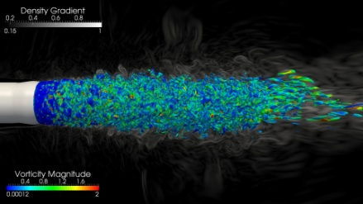
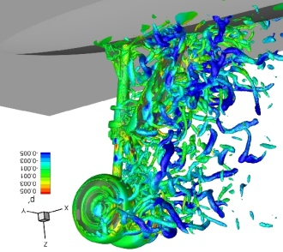
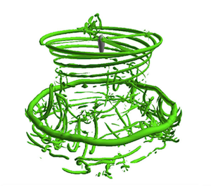
Findings CONTINUED
The accuracy of CFD in the aerospace design process is severely limited by the inability to reliably predict turbulent flows with significant regions of separation
  No single “silver bullet”
  RANS methods will continue to see broad application, and may possibly see improvement via RST methodologies
  Hybrid RANS-LES methods show the most promise as a good compromise between accuracy and affordability → better theoretical approaches for interface region are needed
  LES method development is an active area of research and is progressing → significant investment still needed to enable the technology for broad engineering application in 2030
  Continued investment needed for the development of a validated, predictive, multi-scale combustion modeling capability (e.g., to optimize the design and operation of evolving fuels for advanced engines)
Notes:
11

Slide 12
Case Study: LES Cost Estimates
Wall-modeled LES (WMLES) cost estimates
  Using explicit, 2nd order accurate finite volume/difference
  Unit aspect ratio wing, Mach 0.2 flow
Comparison to current HPC #1 system: Tianhe-2
  55 PFLOP/s theoretical peak; 34 PFLOP/s on Linpack benchmark
  WMLES Re=1e6 feasible today on leadership class machines
2030 HPC system estimate
  30 ExaFLOP/s theoretical peak
  WMLES Re=1e8 feasible on 2030 HPC
Comments:
  These are capability computations (maxing out leadership HPC)
  Simple geometry (unit aspect ratio; isolated, clean wing; etc)
  Algorithmic advances critical for grand challenge problems
24 hour turn-around time
Notes:
12

Slide 13
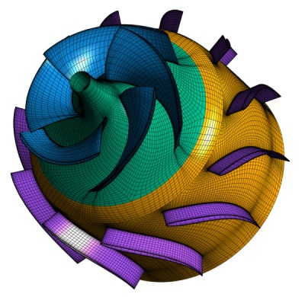
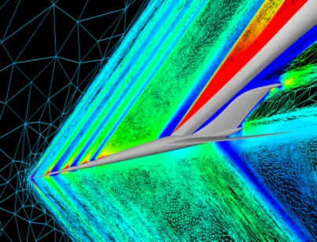
Findings CONTINUED
Mesh generation and adaptivity continue to be significant bottlenecks in the CFD workflow, and very little government investment has been targeted in these areas.
  Streamlined and robust geometry (e.g., CAD) access, interfaces, and integration into CFD processes is lacking
  Large-scale, automated, parallel mesh generation is needed as the size and complexity of CFD simulations increases → goal is to make grid generation invisible to the CFD analysis process
  Robust and optimal mesh adaptation methods need to become the norm
  Curved mesh element generation for higher-order discretizations is needed
  Consider newer strategies like cut cells, strand grids, “meshless”
Notes:
13

Slide 14
Findings CONTINUED
Revolutionary algorithmic improvements will be required to enable future advances in simulation capability.
  Robust convergence behavior for complex geometries and flowfields is lacking → need automated, mesh-tolerant, monotone positivity-preserving and entropy-preserving schemes
  Improved scalability of CFD algorithms on current and emerging HPC hardware is needed → develop “optimal” solvers, improve discretizations (e.g., higher-order)
  Robust uncertainty quantification methods are needed
    Extension of output-based error techniques and grid adaptation is not robust for 3D viscous flows about complex geometries
    Current output-based error estimates can be significantly inaccurate and/or produce unbounded errors
    Error methods for parametric variability (e.g., boundary and initial conditions)
Notes:
14

Slide 15
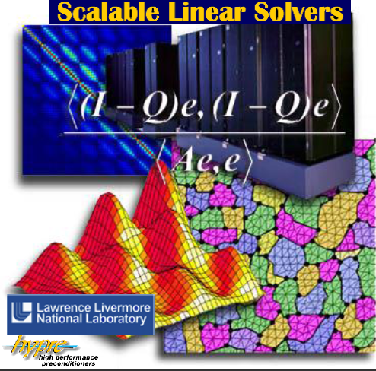
Case Study: Scalable Solvers
Basic research in optimal scalable solvers required to
  Advance numerical efficiency of CFD solvers (basic R&D)*
  Capitalize on emerging HPC hardware (HPC access)*
Asymptotic properties of optimal solvers:
  Gains increase with problem size
  Gains increase with increasing HPC parallelism
  Orders of magnitude possible for large problems
Many agencies have focused scalable solver projects
  e.g. DoE ASCR program, CERFACS
Multigrid used as example
  Initially developed with NASA funding (Brandt & South, Jameson)
    NASA codes utilize older NASA developed multigrid (limitations)
  Considerable on-going development outside of NASA
    LLNL AMG solvers demonstrated on 100,000 cores, 10¹² DOFs
    Not always directly transferrable to aero/CFD problems
Solver development should focus on techniques best suited for important NASA problems
  Hyperbolic, time-implicit, stiff source terms…
*Resources required
Notes:
15

Slide 16
Findings CONTINUED
Managing the vast amounts of data generated by current and future large-scale simulations will continue to be problematic and will become increasingly complex due to changing HPC hardware.
  Tools to effectively visualize, manage, and store single, very-large, high-fidelity simulations must improve → development of innovative visualization and presentation techniques
  Need for the processing (collection, synthesis, and interrogation) of thousands of CFD simulations in real-time → ROM, “meta-models”, etc.
  Development of methods to merge CFD data with other aerodynamic source data (e.g., wind tunnel, flight data) and multi-disciplinary simulation data to create an integrated database (with confidence level) is critical
Notes:
16

Slide 17
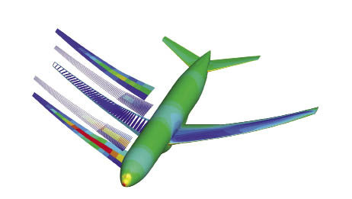
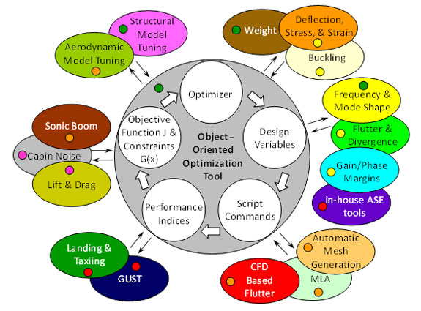

Findings CONTINUED
In order to enable increasingly multidisciplinary simulations, for both analysis and design optimization purposes, several advances are required:
  Individual component CFD solver robustness and automation will be required.
  Development of standards for coupling of CFD to high-fidelity simulations of other disciplines
  Emphasis on the Science of MDAO and the development of stable, accurate and conservatives techniques for information transfer
  Techniques for computing sensitivity information and propagating uncertainties in the context of high-fidelity MDAO problems
Notes:
17

Slide 18
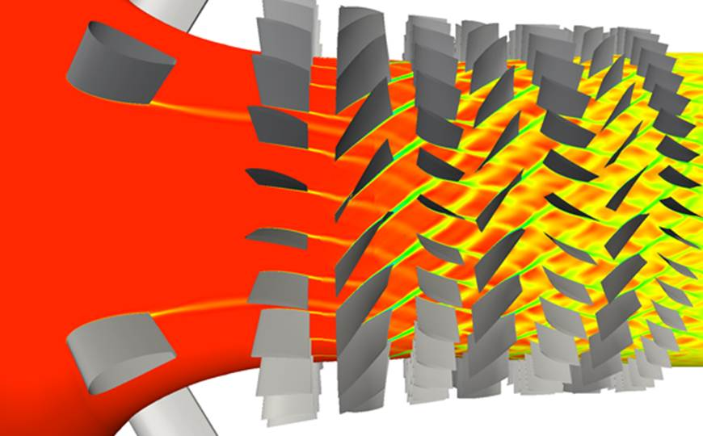
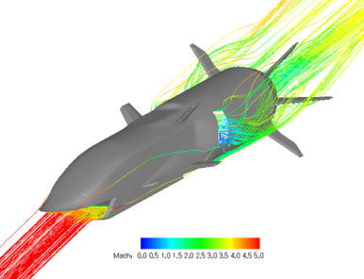
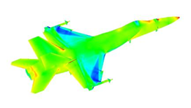
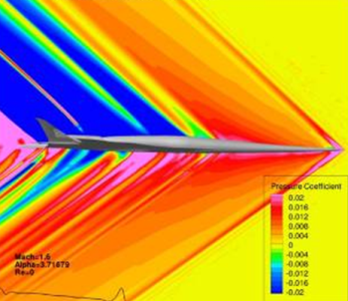
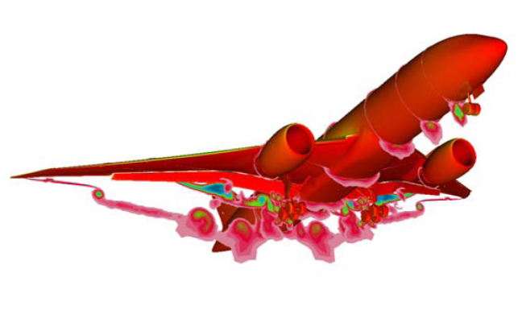
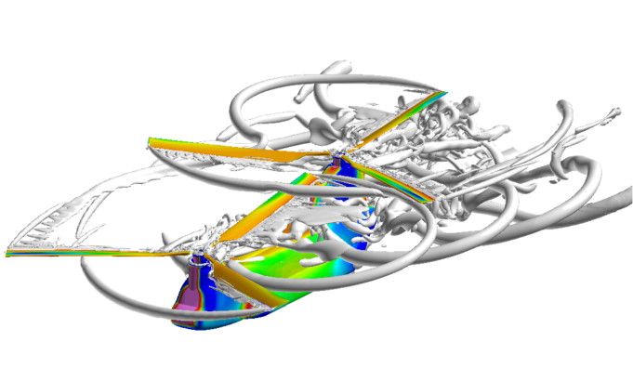
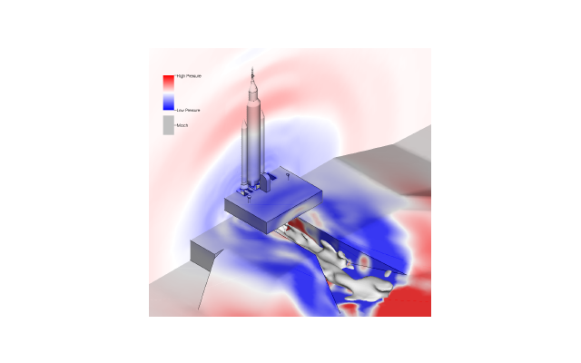
Vision of CFD in 2030
Emphasis on physics-based, predictive modeling
Transition, turbulence, separation, chemically-reacting flows, radiation, heat transfer, and constitutive models, among others.
Management of errors and uncertainties
  From physical modeling, mesh and discretization inadequacies, natural variability (aleatory), lack of knowledge in the parameters of a particular fluid flow problem (epistemic), etc.
A much higher degree of automation in all steps of the analysis process Geometry creation, mesh generation and adaptation, large databases of simulation results, extraction and understanding of the vast amounts of information generated with minimal user intervention.
Ability to effectively utilize massively parallel, heterogeneous, and fault-tolerant HPC architectures that will be available in the 2030 time frame Multiple memory hierarchies, latencies, bandwidths, etc.
Flexible use of HPC systems
Capability- and capacity-computing tasks in both industrial and research environments.
Seamless integration with multi-disciplinary analyses
High fidelity CFD tools, interfaces, coupling approaches, etc.
Notes:
18

Slide 19
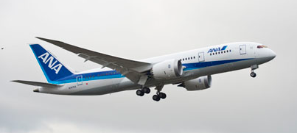
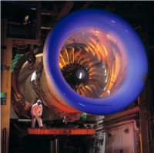
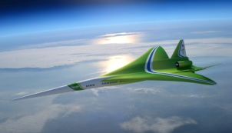
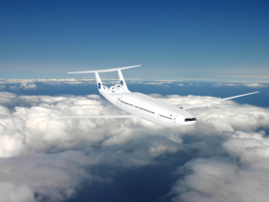
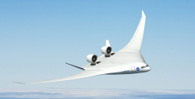
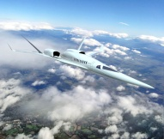
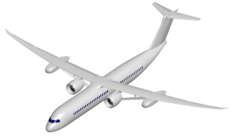
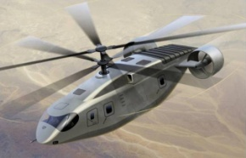
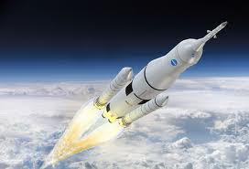
Grand Challenge Problems
Represent critical step changes in engineering design capability
May not be routinely achievable by 2030
Representative of key elements of major NASA missions
  Large Eddy Simulation (LES) of a powered aircraft configuration across the full flight envelope
  Off-design turbofan engine transient simulation
  Multi-Disciplinary Analysis and Optimization (MDAO) of a highly-flexible advanced aircraft configuration
  Probabilistic analysis of a powered space access configuration
Notes:
19

Slide 20
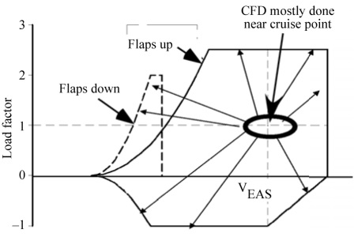
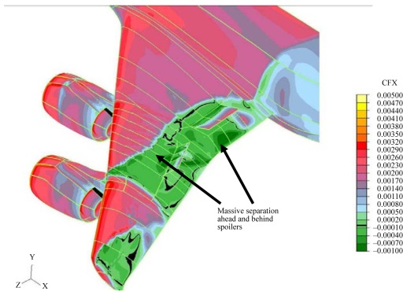
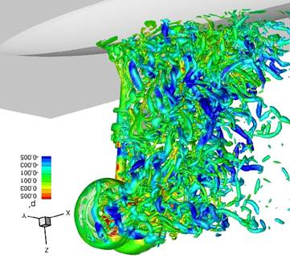
LES of a Powered Aircraft Configuration Across the Full Flight Envelope
Assess the ability to use CFD over the entire flight envelope, including dynamic maneuvers
Assess the ability of CFD to accurately predict separated turbulent flows
  Monitor increasing LES region for hybrid RANS-LES simulations
  Evaluate success of WMLES
  Determine future feasibility of WRLES
Assess the ability to model or simulate transition effects
Project future reductions in wind tunnel testing
Notes:
20

Slide 21

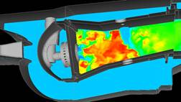
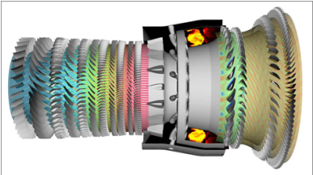
Off-Design Turbofan Engine Transient Simulation
Measure progress towards virtual engine testing and off-design characterization
Assess the ability to accurately predict:
  Separated flows
  Secondary flows
  Conjugate heat transfer
  Rotating components, periodic behavior
Potential to demonstrate industrial use of WRLES for lower Re regions
Assess progress in combustion modeling and prediction abilities
Notes:
21

Slide 22




MDAO of a Highly-Flexible Advanced Aircraft Configuration
Ultimate utility of CFD for aerospace engineering is as component for MDAO
Future vehicle configurations to be highly flexible
Assess progress in analyzing the important multidisciplinary problems: Science of coupling
  Time dependent
  Aero-structural
  Aero-servo-elastic
  Aerothermoelastic
Assess multidisciplinary optimization capabilities
  Availability of sensitivties
  Performance of optimizations
  Optimization under uncertainties
Notes:
22

Slide 23
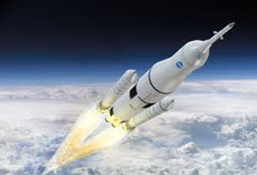
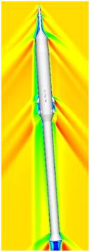
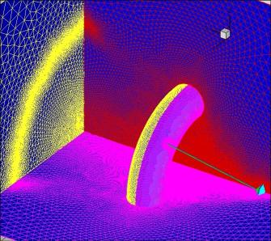
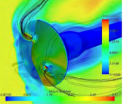
Probabilistic Analysis of a Space Access Vehicle
Opening up new frontiers in space vehicle design hinges on development of more capable high-fidelity simulations
Assess specific relevant capabilities
  Separated turbulent flows
  High-speed/hypersonic flows
  Aero-plume interactions
  Aerothermal predictions
Emphasis on reducing risk through uncertainty quantification techniques
  Unique configurations
  Limited experience base
  Difficult conditions for ground-based testing
Notes:
23

Slide 24
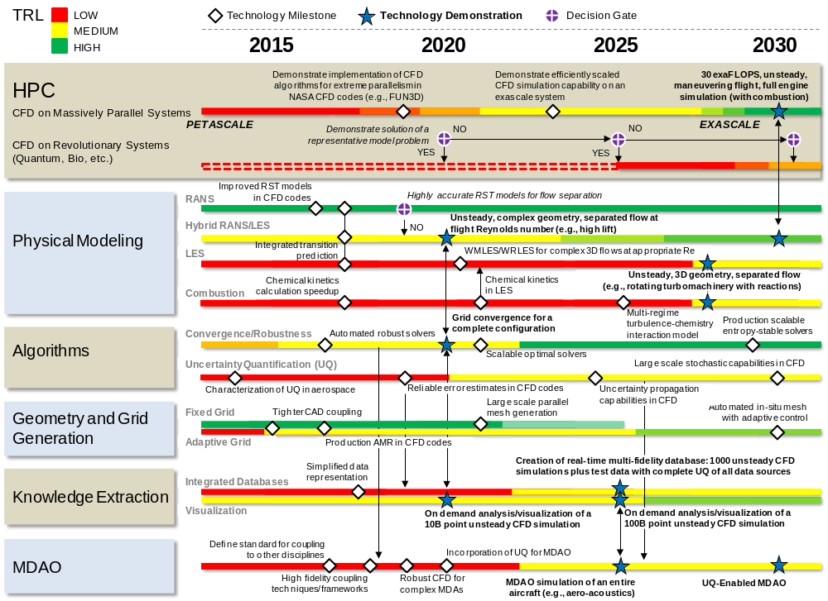
Technology Roadmap

Slide 25
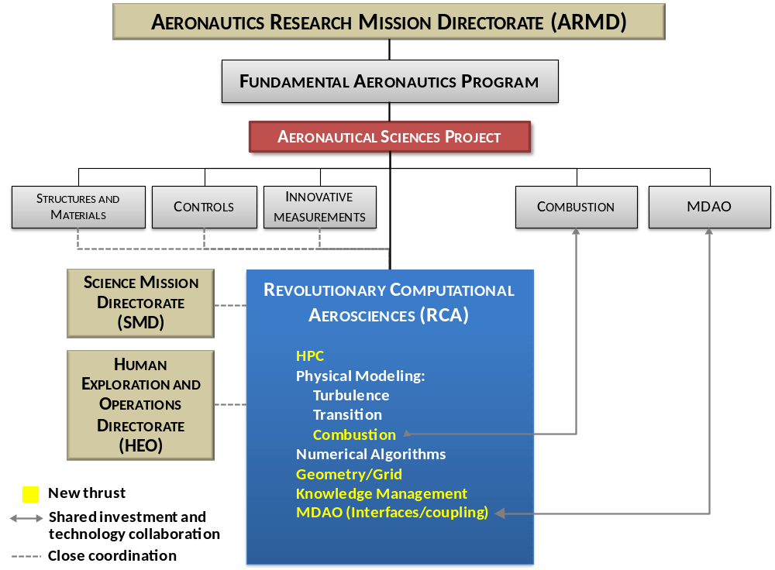
Recommendations
NASA should develop, fund and sustain a base research and technology (R/T) development program for simulation-based analysis and design technologies.
  Required to fulfill technology development plan and address Grand Challenge problems
  RCA program to coordinate ALL key CFD technologies, including combustion and MDAO→ structured around six technology areas
  Success will require collaboration with experts in mathematics, computer science, computational geometry, and other aerospace disciplines
Notes:
25

Slide 26
Recommendations CONTINUED
HPC
Physical Modeling
numerical algorithms
Increasing access to leading-edge HPC hardware
Porting of current and future codes to leading-edge HPC
Radical emerging HPC technologies
RANS turbulence model
Hybrid RANS-LES modeling
  Improved RANS component
  Seamless interface
LES (wall-modeled and wall-resolved)
Transition
Combustion
Advances in current algorithms for HPC
Discretizations
  Higher-order methods
  Low dissipation/dispersion schemes
  Novel foundational approaches
Solvers
  Linear and non-linear scalable solvers
  Enhancements for MDAO and UQ
UQ
  Define aerospace uncertainties
  Leverage known techniques
  Improved error estimation techniques
  Statistical approaches
Geometry and Grid Generation
Knowledge Extraction
CAD access and interfaces
Large scale parallel mesh generation
Adaptive mesh refinement
Visualization
Data-base management
Variable fidelity models
MDAO
Interfaces and standards
Accurate and stable coupling techniques
UQ support and sensitivities (system-level)
Notes:
26

Slide 27
Recommendations CONTINUED
NASA should develop and maintain an integrated simulation and software development infrastructure to enable rapid CFD technology maturation.
  Maintain a world-class in-house simulation capability
    Superior to capabilities within academia and industry
    Cover all key vehicle classes (e.g., external aero, turbomachinery, science and space)
    Critical for understanding principal technical issues, driving development of new techniques, and demonstrating capabilities
  Streamline and improve software development processes
    Create formal software development, maintenance, and testing environment to build new and/or enhance existing NASA CFD tools and processes → streamlines efforts, synergizes development teams, reduces costs
  Emphasize CFD standards and interfaces
    Emphasize common ways of exchanging data (e.g., geometry, grid, MDAO) → streamlines and optimizes development efforts
    Must identify ALL key stakeholders, develop consensus, and advocate for standard approaches
Notes:
27

Slide 28
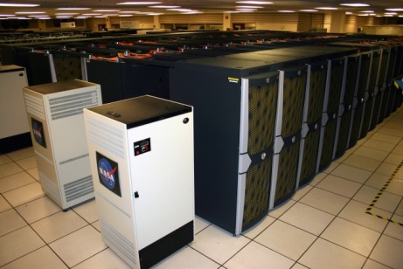
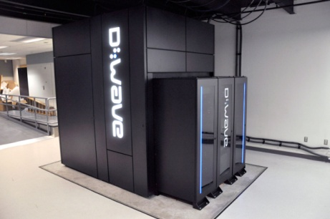
Recommendations CONTINUED
NASA should make available and utilize HPC systems for large-scale CFD development and testing.
  Provide access to large-scale computing for both throughput (capacity) to support on-going programs, but also development (capability) to directly support technology demonstrations and progress towards Grand Challenge problems.
    Mitigates stagnating simulation capabilities
    Drives progress by testing new algorithms at scale
    Develops a more experienced and effective user base both within and outside NASA
  Leverage existing internal, as well as other national HPC resources
  Provide access to novel HPC platforms (e.g., D-Wave) to accelerate technology development
Notes:
28

Slide 29
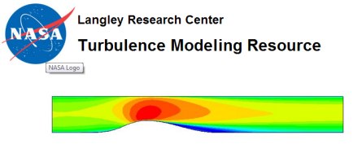
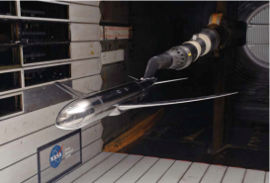
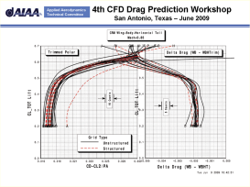
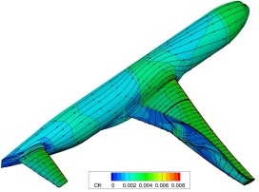
Recommendations CONTINUED
NASA should lead efforts to develop and execute integrated experimental testing and computational validation campaigns.
  High quality experimental test data for both fundamental, building-block and complex, realistic configurations, coupled with careful computational assessment and validation, is needed to advance CFD towards the Vision 2030 goals
  NASA is uniquely positioned to provide key efforts in this area due to the availability of experimental test facilities and experience, as well as key expertise to benchmark CFD capabilities
Notes:
29

Slide 30
Recommendations CONTINUED
NASA should develop, foster, and leverage improved collaborations with key research partners and industrial stakeholders across disciplines within the broader scientific and engineering communities.
  Leverage other government agencies and stakeholders (US and foreign) outside of the aerospace field → collaborate with DoE, DoD, NSF, NIST, etc.
  Actively pursue collaborations with both academia AND industry → Enables accelerated efforts for CFD advances in full flight envelope, reduction of physical testing, and certification by analysis
  Emphasize basic funding in applied math and computer science → Advanced developments in CFD will require breakthroughs in numerical algorithms and efficient solution techniques for emerging HPC systems
  Embrace and establish sponsored research institutes → acts as a centralized focal point for the development of cross-cutting disciplines, engages the broader scientific community, and executes a long-term research strategy
Notes:
30

Slide 31

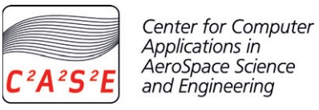

Case Study: Sponsored Research Institutes
Research institutes provide an effective mechanism for:
  Engaging broader scientific community
  Centralizing multidisciplinary & cross-cutting technology R&D
  Enable long-term focus while aligning with agency missions
Self supporting institutes deemed unfeasible
  Compromises long term focus
  Poorly aligned with NASA missions
Examples of aerospace computational science institutes
  CERFACS
    Multidiscplinary: aero, climate, computer science
    Includes public and private funding (6 shareholders)
  C²A²S²E
    Highly focused on external aeronautics
    Includes public and private funding
  ICASE
    Highly successful
    Long term focus required core funding and independent agenda
Institute structure and strategy more important than funding levels
  Must be considered carefully
Notes:
31

Slide 32

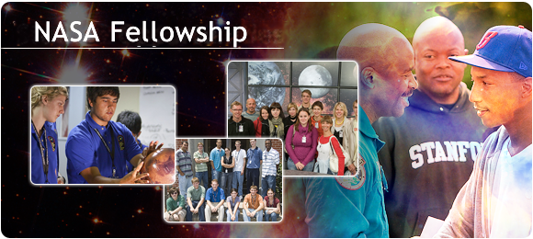


Recommendations CONTINUED
NASA should attract world-class engineers and scientists.
  Success in achieving the Vision 2030 CFD capabilities is highly dependent on obtaining, training, and nurturing a highly educated and effective workforce → need for researchers, developers, and practitioners from diverse backgrounds
  How?
    Expand fellowship programs in key computational areas
    Encourage and fund long-term visiting research programs
    Provide visiting students with meaningful opportunities to make progress towards the solution of Grand Challenge problems
Notes:
32

Slide 33
Answers to the Key NASA Questions
What hardware requirements and software attributes will characterize an advanced “Vision 2030” CFD code that is used to routinely compute complex turbulent flows, involving flow separation, at subsonic, supersonic, and hypersonic speeds, and exhibits greater robustness than current technology?
  HPC systems that provide a dramatic increase in computational power, are fault tolerant, and are available and affordable for the routine, production design and analysis of aerospace vehicles and systems
  CFD flow solvers that:
    run efficiently on future exascale systems,
    predict vehicle/system performance with certifiable accuracy and full quantification of errors,
    utilize optimal solution schemes and intuitive, parameter-free interfaces,
    fully incorporate mesh generation and adaptation as part of the solution,
    employ advanced turbulence and transition models that predict all types of flow separation,
    are seamlessly integrated into visualization and data mining techniques, and
    are effectively coupled with other disciplines in computational mechanics
Notes:
33

Slide 34
Answers to the Key NASA Questions CONTINUED
How many orders of magnitude faster (time-to-solution), as compared with current capabilities, will 2030 CFD technology be?
  Expect 1000-10000x increase in computational power which will enable:
    10¹¹ grid point or equivalent high-order resolution full-configuration steady-state RANS simulations in minutes on commodity hardware, or 10¹² grid point simulation in seconds on leadership hardware
    Equivalent highly resolved steady-RANS based optimization in minutes to hours
    Highly resolved time-dependent production RANS simulations (e.g., full rotorcraft simulations at high spatial and temporal resolution (1/10th degree time step, hundred revs) in hours on commodity hardware)
    Increased emphasis on including more complex physics into the simulations
    Generation of a complete, CFD-based aerodynamic database (~10,000 data points) in under one day using steady RANS (for all flight regimes)
    Tightly coupled multidisciplinary simulations (e.g. aeroelastic, aerothermoelastic, aeroservoelastic, maneuvering aircraft/digital flight) and optimizations at varying levels of fidelity overnight on commodity hardware and in hours on leadership hardware
Notes:
34

Slide 35
Answers to the Key NASA Questions CONTINUED
What will be the fundamental elements of 2030 turbulence models, and for what classes of problems will they be reliable?
  Hybrid RANS-LES methods will continue to improve
    RANS will cover the area where the boundary layer (BL) is too thin for LES (and the area will shrink as computing power rises)
    Simulations at low Reynolds numbers may be treated with LES only
    All high Reynolds number LES will be Wall-Modeled LES
  RANS models will remain very empirical
    Reynolds-Stress Transport models will improve…
    …but may or may not retire “few-equation” models, especially non-linear versions
  Transition prediction will become much more routine
    e^{n} methods and those based on empirical transport equations will co-exist
    The primary challenge is integration of e^{n} methods with flow solvers
  The accuracy of aerodynamics CFD will be competitive with wind tunnels
    Fair or better prediction of BL transition and separation (RANS + LES)
    Fair or better predictions after massive separation (LES)
    Affordable for attached flows; expensive for wide range of scales (e.g., AFC)
    Full Reynolds number and Mach number with access to flow field data leading to better understanding of flow physics through advanced visualization
  CFD combustion predictions will be less competitive (than aero)
    Turbulent combustion models will remain challenged by modeling at the subgrid scale
Notes:
35

Slide 36
Answers to the Key NASA Questions CONTINUED
What are the principal impediments, both modeling and algorithmic, that must be overcome to achieve the 2030 CFD vision?
  Effective utilization of HPC
    Need for scalable solver/algorithm/pre-post-processing development
    Software issues/programming paradigm
    Lack of access to HPC for scalable software development and testing
  Physical modeling
    Turbulent separated flow:
      RANS models stagnant and inadequate
      Hybrid RANS-LES rely on RANS and require better RANS-LES interface
      Sheer cost of LES with current discretizations/solvers
    Transition modeling
    Combustion
Notes:
36

Slide 37
Answers to the Key NASA Questions CONTINUED
What are the principal impediments, both modeling and algorithmic, that must be overcome to achieve the 2030 CFD vision?
  Autonomous and reliable CFD
    Cumbersome CAD/mesh/adaptivity processes
    Lack of optimal and scalable solvers (impediment grows with problem size)
    Unreliable error estimates
    Uncertainty quantification implemented as after-thought or not at all
  Knowledge extraction and visualization
    Effective analysis of large simulation (e.g. parallel co-visualization)
    Real time processing of entire simulation databases
    Merging of variable fidelity simulation data and experimental data
  Multi-disciplinary/multi-physics simulations and frameworks
    Robustness and automation of CFD within MDAO
    Science of multidisciplinary coupling at high fidelity
    Fully coupled sensitivities
    Frameworks/standards
Notes:
37

Slide 38
Answers to the Key NASA Questions CONTINUED
What high-risk/high-yield obstacles remain as enduring and daunting challenges that should be the focus of long-range efforts by NASA?
  Daunting challenge:
    Develop reliable physics-based high-fidelity MDAO tools for aerospace vehicle analysis, design, and reduce risk through quantifiable uncertainties
      For aeronautics and space vehicles
  High-Risk/High-Yield:
    Our listed obstacles show that this will not be achieved by investment in one or two specific technologies (e.g. current LES approaches remain out of reach due to cost considerations)
    Requires investment in broad range of synergistic technologies to bring step changes in simulation capability to fruition
      Foundational (applied math, computer science, physical modeling)
      Combine algorithmic advances with HPC advances
  Organizational, cultural, and collaborative challenges are just as important as technical challenges and must be addressed
Notes:
38

Slide 39
Backup

Slide 40
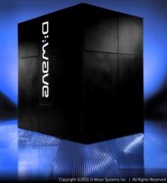
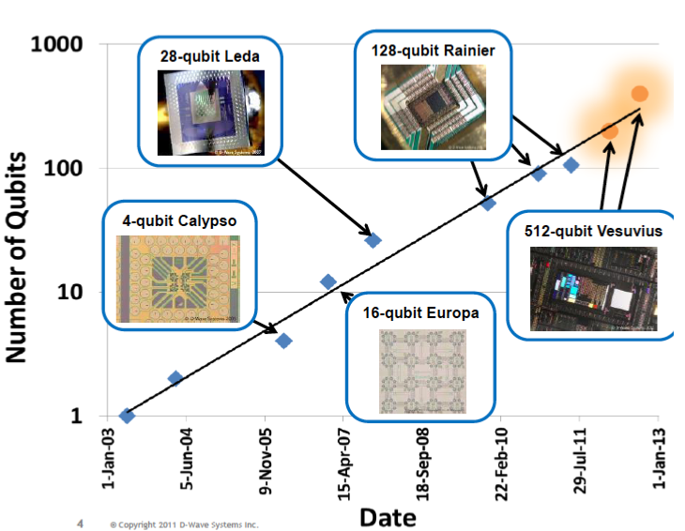
Thoughts on Revolutionary Approaches
Advances in CFD between now and 2030 will likely include both evolutionary improvements to current tools, methods, and processes, and revolutionary, “paradigm-shifting” advances in technology.
Although revolutionary breakthroughs cannot be predicted, emerging technologies that promise significant advances in capability, such as quantum or bio-computing, must be properly followed and nurtured.
Evolutionary improvements in CFD technology (e.g., upwind shock capturing algorithms) do lead to revolutionary advances in simulation capability (e.g., routine prediction of cruise drag).
Unstructured mesh technology development:
First demonstration of full aircraft CFD using unstructured mesh (full potential) : Dassault Aviation 1982
First demonstration of full aircraft CFD using unstructured mesh (Euler equations): Jameson 1985
NASA unstructured mesh development: initiated in 1990's (FUN3D)
Unstructured mesh RANS solvers dominant approach (e.g. DPW series by late 2000s)

Slide 41
CFD Survey
Objectives
  Collect critical feedback from the engineering and scientific communities on key topics related to CFD
  Develop definitive views on CFD requirements, shortcomings, and impediments
  Identify key discussion topics for CFD workshop
Conducted during February 2013
  Hosted by SurveyMonkey
  175 total participants
  22 total questions (14 technical)
  Excellent feedback (especially the written responses)

Slide 42
CFD Survey – What We Learned
CFD requirements captured well by Vision 2030 CFD team
68% would use increases in HPC for MDA/O and multi-physics analysis
Most important enhancement to CFD: Increased accuracy of flow physics modeling
Critical impediments: Lack of validation datasets, academia/govt/industry coordination, CFD best practices
Primary focus of turbulence model development: Enhancement to hybrid RANS/LES models
User aspects: More automation, faster visualization, need for hard error estimates, more feedback (solver, trouble areas)
MDA/O: Most critical discipline to couple – Structures
MDA/O: Key issue – Integration

Slide 43
CFD Survey – What We Learned
Revolutionary capabilities: Certification, maneuvering flight, full flight envelope + aeroelastics + complete engine effects
CFD software development: Better interaction between math/CS/engineering, better software engineering practices
HPC: Speed-up likely through parallelism, Quantum computing unlikely to be ready by 2030
Long term development plan: Improvements to physical modeling and numerical algorithms (44%), streamlining and error-proofing of CFD processes (25%), enhancements to parallel computing efficiency (19%)
Use and impact: CFD will be easier for non-experts, CFD will be used earlier in the design process, CFD will reduce/replace physical testing
Development and validation of large-scale CFD simulations

Slide 44
CFD Workshop
Develop consensus view of key requirements and impediments
Held 1-2 May 2013 at NIA in Hampton, VA
50+ attendees (16% academia, 46% government, 32% industry, 6% CFD software vendors)
7 sessions each covering a specific discussion topic:
    Revolutionary Thoughts
    HPC Trends, Software Development
    Turbulence Modeling, Separated Flows, etc.
    Numerics, Error Quantification, Solution Quality
    Geometry, Grid, CFD Process
    Complex Flow Physics
    MDA/O, Multi-Physics

Slide 45
CFD Workshop – Key Issues
Unsteady, turbulence/transition/separated flows
  Numerical efficiency and accuracy
Autonomous and reliable CFD
  Geometry
  Grid generation, adaptation, convergence
  UQ: Modeling, Numerical, Natural Variability
Knowledge extraction
  Data mining, data fusion (merging CFD/test, etc.), “Big Data”
HPC challenges
Interface/frameworks for MDA/O, multi-physics
CFD Validation
Coordination/Collaboration
Education of the CFD Workforce
★ “Surprise”

Slide 46
Team Structure
Boeing
Research & Technology
Greg Hyslop, President
Technical Advisory Team
Mark Anderson, Leader
Flight Sciences
Technology
Mark Anderson, Director
Boeing Business Team
Kurt Bratten
Program Manager
Abdi Khodadoust
NASA COTR
William Kleb
Airframe
Boeing
Jeffrey Slotnick
Principal Investigator
Propulsion
Pratt & Whitney
Elizabeth Lurie
Focal
HPC
NCSA
William Gropp
Focal
Academia
Research Team
David Darmofal, MIT
Focal
NASA and
Government Lab
Researchers
T. Antani, Boeing
K. Bowcutt, Boeing
M. Mani, Boeing
R. Narducci, Boeing
P. Spalart, Boeing
J. Vassberg, Boeing
V. Venkatakrishnan, Boeing
R. Bush, P&W
J. Croxford, Boeing
M. Lamoureux, P&W
W. Lord, P&W
R. Shaw, Boeing
N. Somanath, P&W
D. Dominik, Boeing
P. Fussell, Boeing
J. Gablonski, Boeing
J. Alonso, Stanford
D. Mavriplis, Wyoming
Sandia
AFRL
…

Slide 47
Statement of Work
3.2 Initial Vision of 2030 CFD Code
3.2.1 Initial Vision Development
  Collect and establish requirements (Deliverable 2)
  Identify shortcomings and gaps in current CFD technology
  Consider interplay of 2030 CFD Code with multi-physics analysis capabilities, quantification of computational uncertainty, and emerging High Performance Computing (HPC) infrastructure
  Identify impediments to achieving the 2030 Vision CFD Code
3.2.2 Survey of CFD Community
  Develop and conduct comprehensive technical survey to pulse CFD and scientific communities on CFD requirements, gaps, limitations, and impediments
  Develop list of CFD limitations, gaps, and impediments (Deliverable 3)
NASA Centers | Government Labs | Aerospace Industry
Academic Institutions | HPC Community | CFD Vendors

Slide 48
Statement of Work
3.3 Refined Vision of 2030 CFD Code
3.3.1 Collect Survey Feedback (Deliverable 4)
  Create a comprehensive summary of CFD community survey results
  Obtain feedback from CFD community on survey results
3.3.2 Vision 2030 CFD Code Workshop
  Plan and host a 2-3 day joint workshop between Boeing team members, NASA FAP and CFD leaders, and the broader CFD community
    Establish a definitive view on requirements, priorities, roadblocks, and impediments
    Develop realistic technical approaches and generate new ideas in improving CFD capability
    Assemble consensus and actionable plans for maturing CFD technologies (using the TRL scale), including identifying validation activities and computational resources
    Develop initial timeline for required research

Slide 49
Statement of Work
3.4 Mid-Term Review
Present a finalized vision of the 2030 CFD Code
Present an outline of the initial research plan and technology development roadmap
Develop and deliver mid-term review presentation package (Deliverable 5)

Slide 50
Statement of Work
3.5 Vision 2030 CFD Code Integrated Plan and Roadmap
3.5.1 Develop Detailed Research Plan and Roadmap
  Technology trends
  Anticipated technology challenges
  Success metrics and appropriate exit criteria
  Estimated 2030 code performance
3.5.2 Develop System-Level View of Architecture
  Numerical algorithms and solution technology
  Software design
  Acknowledge and consider likely interconnectivity with future multi-disciplinary design/optimization and analysis systems
3.5.3 Answers to the Key NASA Questions

Slide 51
Statement of Work
3.6 Final Review
Present a complete summary of the Vision 2030 CFD Code including comprehensive research plans and technology roadmap
Develop and deliver final review presentation package (Deliverable 6)

Slide 52
Statement of Work
3.7 Final Report
Provide a written report for the complete summary of the Vision 2030 CFD Code including comprehensive research plans and technology roadmap (Deliverable 7)

Slide 53
Deliverables
# | DELIVERABLE | TASK REF | FORMAT | DATE
1 | Kickoff meeting presentation package | 3.1 | Presentation MS Powerpoint | 26 October 2012
2 | Initial 2030 CFD Code Requirements | 3.2.1 | Informal Report MS Word | 28 November 2012
3 | CFD limitations, gaps, and impediments | 3.2.2 | Informal Report MS Word | 21 December 2012
4 | Survey Input Summary | 3.3.1 | Informal Report MS Word | 28 February 2013
5 | Mid-term Technical Review Presentation Package | 3.4 | Presentation MS Powerpoint | 27 March 2013
6 | Final Technical Review Presentation Package | 3.6 | Presentation MS Powerpoint | 28 August 2013
7(a) 7(b) | Final written report (draft) Final written report | 3.7 | NASA Contractor Report Format | 28 August 2013 27 September 2012
8 | Monthly Project Telecon minutes | 5.2 | Informal Report MS Word | 5 working days after meeting
9 | Monthly Progress Reports | 5.3 | Informal Report MS Word | 15th calendar day of following month

Slide 54
Meeting & Teleconference Schedule
PROPOSED
REF | MEETING | DATE | DURATION | LOCATION
3.1 | Kick-Off Meeting | 31 October 2012 | 1 Day | NASA Langley
4.1 | Monthly Project Meeting Telecons | 3rd Thursday of each month (8am-9am PST) | 1 hr | Telephone WEBEX
3.3.2 | 2030 Vision CFD Code Workshop | 5-7 March 2013 | 3 Days | TBD
3.4 | Mid-Term Technical Review | 27-28 March 2013 | 2 Days | NASA Langley
3.6 | Final Technical Review Meeting | 24-25 September 2013 | 2 Days | NASA Langley

Slide 55











Technical Approach
Today
NASA
Requirements developed for N+2/N+3 systems, including noise, emissions, fuel consumption targets, etc.
2030
Academics
Gov’t Labs
Industry Labs
Identify current CFD technology gaps and shortcomings
Industry
Define anticipated aerodynamic
and performance
requirements for competitive
aerospace vehicle and systems
HPC
Establish expected computing performance and likely outlook for CFD technology application
DoD
Determine impediments and roadblocks
Detailed Research Plan and Technology Roadmap

Slide 56


